Slide 1

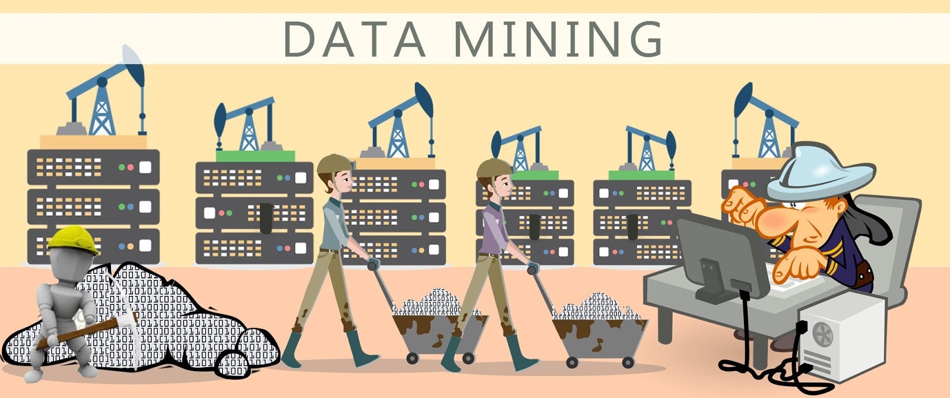
Data Mining
CHAPTER 5
Business Intelligence: Carlo Vercellis

Slide 2
Data Mining
Evolving technologies of information gathering and storage; large amount of data sets; complex analysis
Set of related activities referred to as ;data mining, knowledge discovery, pattern recognition, machine learning
Iterative process
Experts on the application domain – cooperate with – data analysts who use mathematical models.

Slide 3
Data Mining
Refers to the overall process consisting of data gathering and analysis, development of inductive learning models and adoption of practical decisions and consequent actions.
Is the process of exploration and analysis of a dataset to find regular patterns, to extract relevant knowledge.
Characteristic of data mining – Procedure of collection of data and inserting them into the database
The data mining process is based on inductive learning methods, whose main purpose is to derive general rules starting from a set of available examples, consisting of past observations recorded in one or more databases.
models and patterns:- linear equations, sets of rules in if–then–else form, clusters, charts and trees.

Slide 4
Data Mining Activities
INTERPRETATION
Identify regular patterns in the data
Express the patterns through rules and criteria
Rules generated must be original and non-trivial
PREDICTION
Anticipate the value that a random variable will assume in the future
Estimate the likelihood of future events.

Slide 5
Models and methods for data mining
Classification trees or association rules – machine learning/knowledge discovery
Regression /Bayesian classifiers
Probability/optimization theory
Linear regression model – best known learning and predictive method
Linear regression is used to relate a dependent response variable Y to an independent predictor X; in the form Y=aX+b; a and b are parameters to be determined using past observations.
Steps
  Selection of a class of models for representing patterns of data.
  Definition of a metric for evaluating the effectiveness and accuracy of models
  Design a computational algorithm – optimizing the evaluation metric

Slide 6
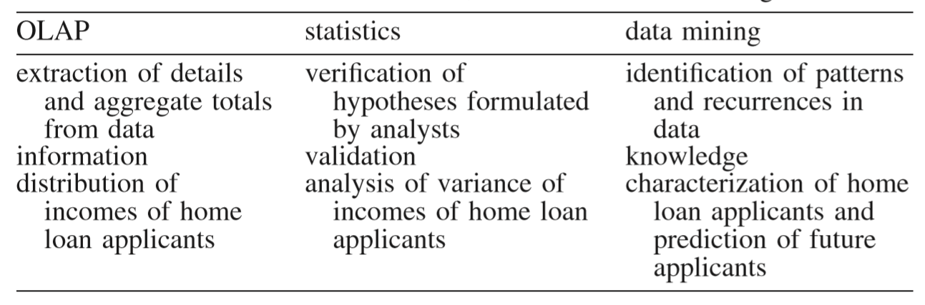
Data mining,classical statistics and OLAP
*OLAP – Online Analytical Processing

Slide 7
Applications of data mining
Relational Marketing – marketing campaigns:cross-selling, up-selling, market basket analysis
Fraud detection – insurance and banking (illegal activities)
Risk Evaluation – Estimate the risk connected with future decisions; granting loan based on the characteristics of the customer
Text Mining – web search engines, filters for email messages
Image Recognition – recognize written characters,identify human faces, detect suspicious behaviours
Web mining – Analysis of clickstreams (sequences of pages visited) for e-commerce sites or e-learning sites
Medical Diagnosis – Early detection of diseases, Image analysis

Slide 8
Representation of input data
2 Dimensional table- data set
Rows – instances,observations,records
Columns – attributes,variables,characteristics
Categorical - whether a customer is using pre-paid or post-paid
Numerical – Amount of outgoing phone calls during a month
Counts – true or false; a bank’s customer may/may not hold credit card.
Nominal – categorical attributes without natural ordering; province of residence
Ordinal - categorical attributes with natural ordering; education level
Discrete – numerical that has finite number of values
Continuous – numerical that has uncountable infinite number of values.

Slide 9
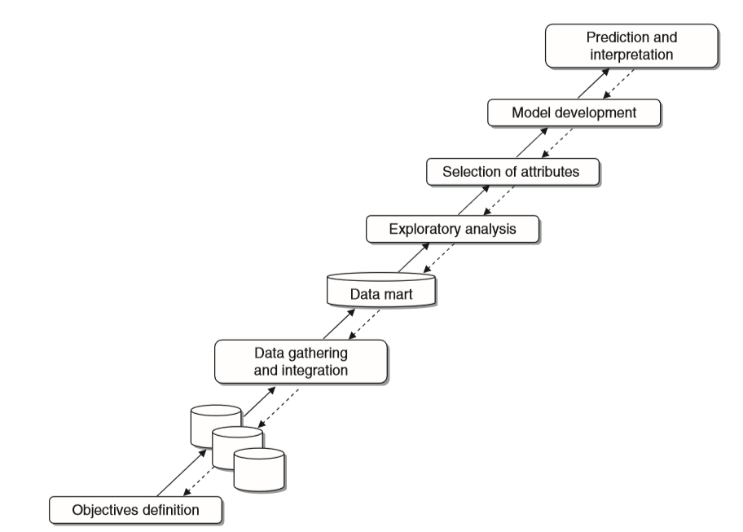
Data Mining Process

Slide 10
Analysis Methodologies
Supervised and unsupervised learning processes
  “Supervised” means training data has ground truth tables to learn from.
  “Unsupervised” means no truth tables for training data.
Seven data mining tasks
  Characterization and discrimination -S
  Classification -S
  Regression - S
  Time Series analysis - S
  Association rules -U
  Clustering -U
  Description and visualization - U

Slide 12

CLASSIFICATION (Supervised)
  Training Set(labelled images)
  Test Set (not a part of training set but used for evaluation)
  Yes/No Questions
REGRESSION (Supervised)
  How many customers will visit the website?
  What will be the income from the clicks on the websites?
  How many human figures in this picture?
CLUSTERING (Unsupervised)
  Put the objects in a group

Slide 13
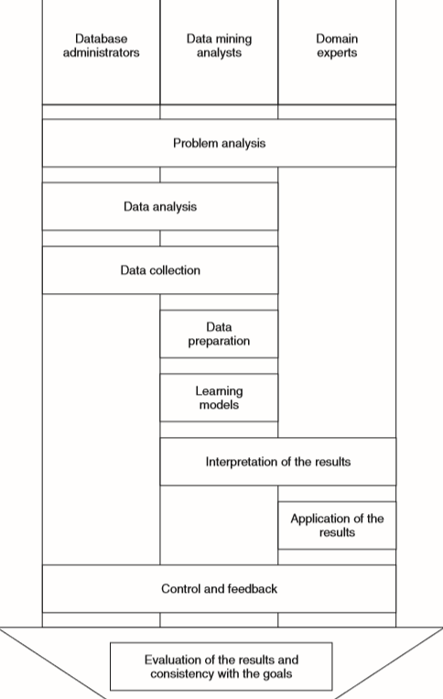
Actors and roles in the data mining process

